Slide 1
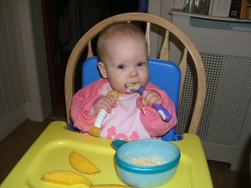
Current issues in complementary feeding what is the evidence?
Charlotte Wright
Professor of Community Child Health / Consultant Paediatrician
University of Glasgow

Slide 2
Plan for presentation
What sort of evidence is there and how good is it?
What it tells us about
Optimal age of starting complementary solids
Baby led weaning
Micronutrients
Vegetables

Slide 3
What sort of evidence is there?
Trials
4 trials on age of first solids
2 trials on early introduction of allergens
Many trials on iron supplementation
National surveys
Infant Feeding survey
National diet and nutrition survey in young children
Cohort studies
Loads!
Experiments – can inform causation
Flavour /texture learning

Slide 4
Randomised control trials
Only difference between groups should be exposure / treatment
Can establish causation as long as properly conducted
True randomisation
Pre-stated primary outcome
Analysis of all subject in randomised groups (intention to treat)
Expensive and difficult to conduct , so usually few relative to observational studies
Still highly informative and never lightly ignored

Slide 5
Observational studies cannot establish causation
Smoking
Suicide

Slide 6
Exposure to risk factors usually determined by other key characteristics
Smoking
Suicide
Deprivation, mental health problems

Slide 7
Causation but in which direction?
Child ever been on a diet
BMI higher at follow up

Slide 8
Outcome was present before exposure and led to exposure to the risk factor
Child ever been on a diet
BMI higher at follow up
Obesity at baseline

Slide 9
How can we use observational data to identify likely causal relationships?
Adjust for all available confounders
Full adjustment rarely possible
Look for consistency with trials
Seek data from other cultures with different underlying relationships
e.g. associations with breastfeeding in developing country

Slide 10
What is the optimal age of starting complementary solids?

Slide 11
What is the optimal age of starting complementary solids?
Too early
Solids displace breast milk needed for immune protection

Slide 12
What is the optimal age of starting complementary solids?
Too late
Slow growth / weight gain
Micronutrient deficiency
Missed opportunity to develop tastes and feeding skills?
Increased risk of allergy?

Slide 13
Does delaying till 6 months compromise weight gain / micro nutrients?
Good evidence from 4 RCTs 1994-2012:
No difference in growth or weight gain when starting solids at 4 or 6 months
Lower iron stores, but not higher rates of deficiency
Stable isotope study:
Increase in milk production as infant grows
6 months = fine

Slide 14
Does delaying till 6 months compromise development of tastes and feeding skills?
Hypothesised ‘critical’ period for introduction of solid foods
Association in observational studies between ‘delayed’ (>4m) solid feeding and poor acceptance of variety and textures
But infants who start solids early likely to be more developmentally advanced and eager to feed
Honduran age of weaning RCT (1995) found no difference in appetite or food acceptance
Recent observational study (mean age solids 5m) found no association with food acceptance
No evidence for critical period in first year

Slide 15
Does delaying till 6 months cause allergy?
LEAP study: high risk infants randomised to start peanuts with first solids or avoid till age 5 years
Most aged >5m at first solids
Allergy 7 times higher in avoidance group (14% vs 2%)
EAT study: unselected breastfeeding infants randomised to start multiple allergens aged 3-4m
Poor compliance, but most at least partially adhered
No difference between randomised groups in primary outcome
Some evidence of adverse effects
‘Per protocol’ observational analysis found reduced peanut allergy only in adherent group compared to controls
Introduction in first year beneficial, no benefit from
introduction <6 months
Notes:
Early group had significantly higher rates of upper respiratory tract infections and a near significant increase in other infections (P=0.07)

Slide 16
The optimal age of starting complementary solids is 6 months
Any one who says otherwise has not looked at (all) the evidence

Slide 17
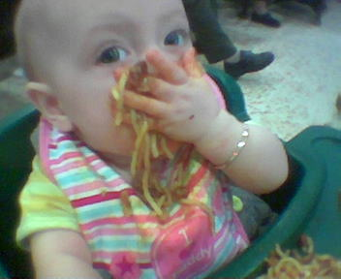
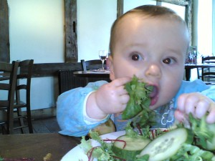
Baby led weaning
Parent / web based movement
http://www.babyledweaning.com/
First complimentary foods offered as bite size solids and infant left to self feed
No spoon feeding at all
Claimed to enable infants to regulate their energy intake more effectively and be less coercive

Slide 18
Research on baby led weaning
All observational research, mainly web based
BLW associated with earlier exposure to family foods
Most BLW mothers actually use mixed approach
Many other differences between BLW mothers and PLW mothers
Less restrained and anxious about food
Less controlling
More affluent and better educated

Slide 19
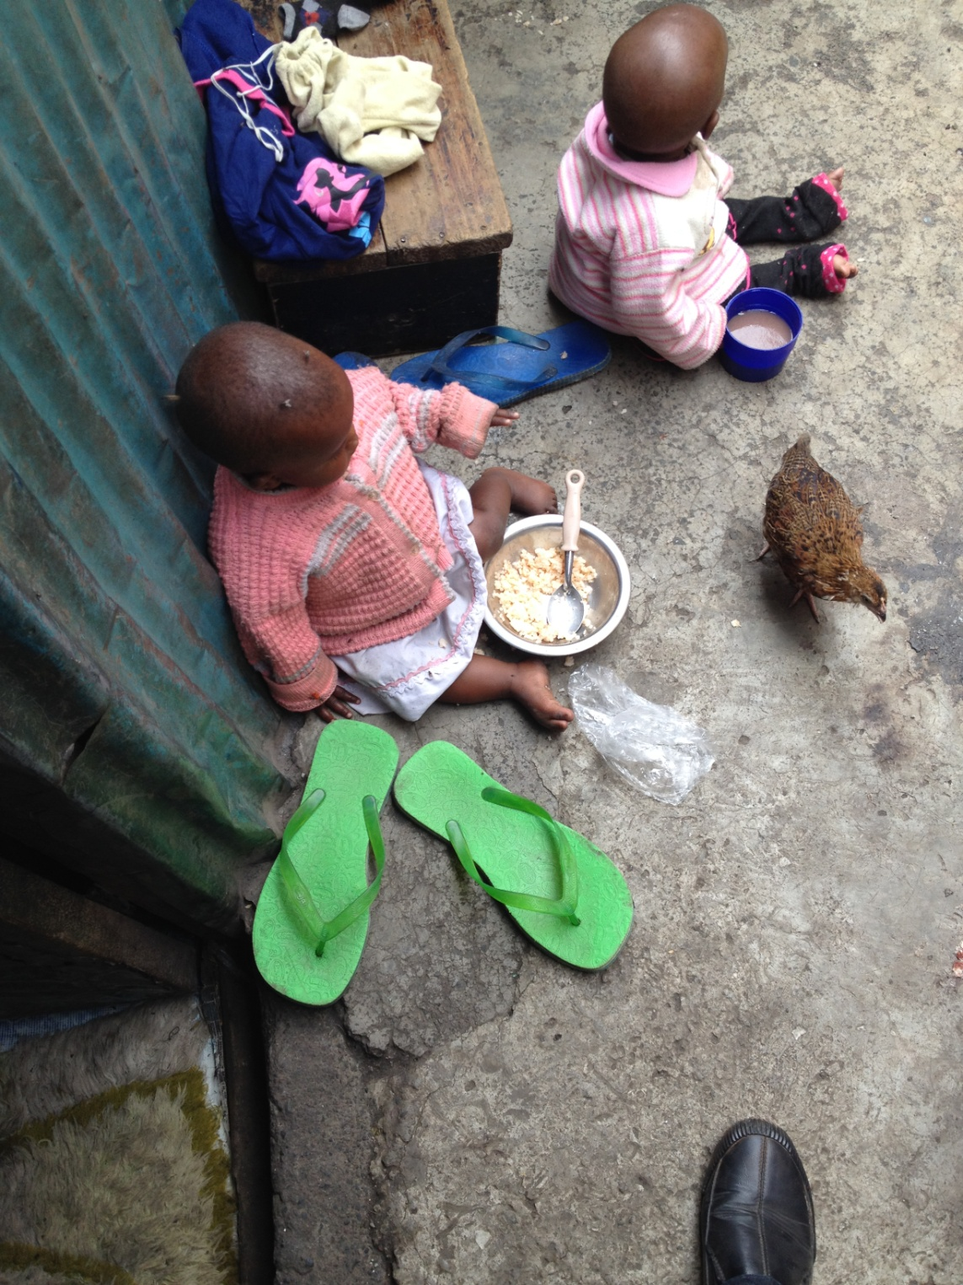
Is baby led weaning safe?
1 in 7 children in GMS cohort had not reached out for food by 7 months
Little or no useful solid intake in first 2 months
One small study found BLW babies more likely to be underweight (5% vs 0)
Choking: a risk for all types of weaning?

Slide 20
Which micronutrients matter in the infant diet?

Slide 21
Which micronutrients matter in the infant diet?
Vitamins and minerals essential for successful growth and development
Most vulnerable micronutrients worldwide at this age are
Iron
Vitamin D
Vitamin A
Zinc

Slide 22
Zinc
Web search:
“One epidemic that most folks in the U.S. are probably unaware of is zinc deficiency”
Department of Health advice:
“You should be able to get all the zinc you need by eating a varied and balanced diet. If you take zinc supplements, don't take too much as this could be harmful”
Not a problem

Slide 23
Iron deficiency
Prevalence
Anaemia: 3% in children under 2
Low stores 10-15%?
Much less common than previously
Risk factors
Large volumes of unmodified milk + restricted diet
Notes:
trials have shown improved cognition in active treatment arms

Slide 24
Potential dietary sources of iron
Haem iron – most bioavalable
Red meat, liver, eggs
Unbound natural iron
Beans, pulses, nuts, dried fruit, whole grains
Fortified foods
Commercial baby foods
Formula milk
Breakfast cereals

Slide 25
Actual dietary sources of iron in infants
Haem iron – most bioavalable
Red meat, liver, eggs
Unbound natural iron
Beans, pulses, nuts, dried fruit, whole grains
Fortified foods
Formula milk
Breakfast cereals
Commercial baby foods

Slide 26
Prevention of Iron deficiency
Encourage diverse complementary diet
Include red meat, if not vegetarian
Avoid unmodified milk
Seems already to have reduced prevalence of anaemia
Limit volume taken over 12 months to 500 mls per day
Supplementation trials have found no benefit in iron replete children and may be harmful
Highly fortified milks could be a risk?

Slide 27
Sources of Vitamin D
Natural source is by synthesis in the skin in response to UVB sunlight
Low levels in northern Europe in Winter
Skin pigmentation reduces exposure
Clothes and being indoors does too!
Few natural food sources: oily fish, cod liver oil
Vitamin D added to many foods (fortification)
Breakfast cereals
Margarine
Formula milk

Slide 28
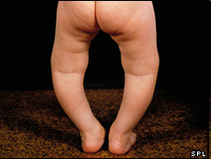
Vitamin D deficiency
Vitamin D levels < 25 nmol/L
2-8% of children under three
36-42% British Asian 2 year olds
Symptomatic deficiency (Rickets)
Prevalence unclear
≈0.1% births in Glasgow
Almost all in ethnic minorities
Little or no solid food
Dark skinned
Mothers deficient in pregnancy
No supplementation

Slide 29
Prevention of Vitamin D Deficiency
Target high risk groups for supplementation
Multivitamins in pregnancy
Vitamin D from birth for high risk?
Stamp on suggestions that breast feeding is a ‘risk factor’ for deficiency

Slide 30
Vitamin A
Deficiency states hardly ever seen in UK
High levels can be toxic
Included in healthy start vitamins (after withdrawal of cod liver oil)
Also added to formula milk
Taking both could exceed tolerable upper limit
Only a problem in excess

Slide 31
Fruit and vegetables
Early exposure assumed to be important
Associated with higher later intake
Multiple exposures facilitate acceptance
But toddlers eat more F&V than children
Mean intake at 18m = 2 adult portions
Eating more fruit than children aged 11-18
Is early exposure actually the key issue?

Slide 32
How much do (extra) micronutrients and vegetables matter in the infant diet?
Western diet is diverse and nutrient rich
even snack foods and ‘unhealthy’ foods
Deficiency states occur only in infants and toddler with very restricted diets
Concerns about diet quality may lead to
Food aversion
Reliance on processed foods
Need to be more chilled about this?

Slide 33
Any questions?

